Slide 1
How do consumers make purchasing decisions?
Exploratory data analysis Project by Esther a. dick

Slide 2
CONTENT
SLIDE NUMBER
3-9. DESCRIPTIVE STATISTICS
10. HYPOTHESIS TESTING
11. CORRELATION ANALYSIS
12. FINDINGS

Slide 3
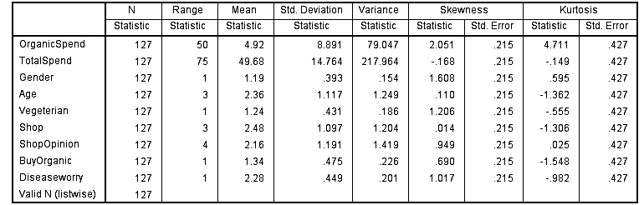

DESCRIPTIVE STATISTICS

Slide 4
The total number of respondents was 127
Nine variables were used for the analysis and they include gender, age, vegetarian, buy organic product or not, Disease worry or not, shop, shop opinion, amount spent on organic product and, total spenditure.
The kurtosis and skewness with their standard error computation shows that the data to be analyzed is normally distributed (-1.96 and +1.96) . The analysis uses 95% confidence level.

Slide 5
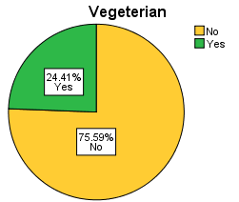
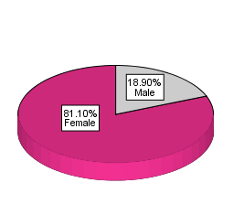
There are 103 (81.10%) female and 24(18.90%) male in respondents
31(24.41%) persons out of 127(100%) are vegetarians and 96 (75.59%) are not vegetarians

Slide 6
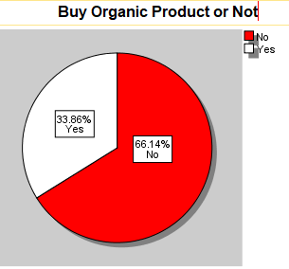
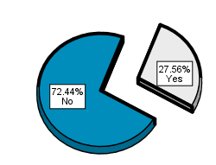
43 (33.86%) respondents buy organic products and 84 (66.14%) do not buy
92 (72.44%) of the customers were not worried about disease while 35 (27.56%) were worried about disease
Disease Worry

Slide 7
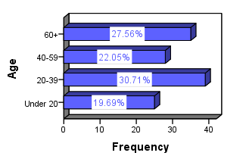
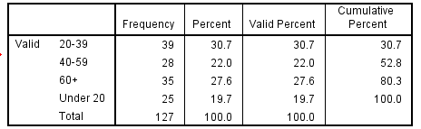
The ages of the respondents were classified into four namely; Under 20, 20 -39, 40 – 59, 60+

Slide 8
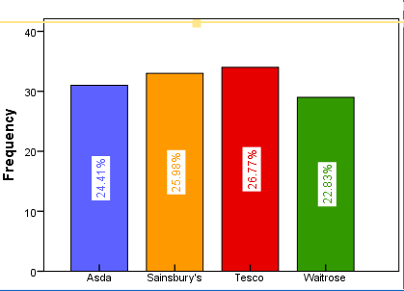
There are four shops namely Asda, Sansbury’s, Tesco and Waitrose
SHOP | FREQUENCY | PERCENT
Asda | 31 | 24.4
Sainsbury’s | 33 | 26.0
Tesco | 34 | 26.8
Waitrose | 29 | 22.8
Total | 127 | 100.0

Slide 9
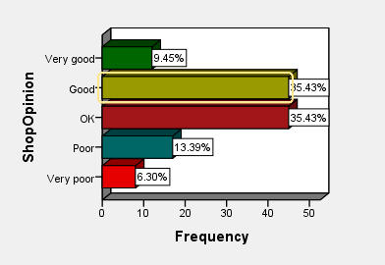
The customers review (opinion) of each shop is categorized into five levels of satisfaction namely; Very poor, Poor, Ok, Good and Very good.

Slide 10
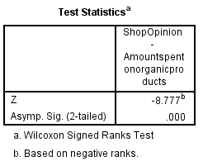
HYPOTHESIS TESTING
The result shows that there is a statistical support for the research hypothesis. So, the research hypothesis is accepted.
RESEARCH HYPOTHESIS
H1: The decision to buy organic product or not is affected by the customer opinion of the shops
NULL HYPOTHESIS
H0: The decision to buy organic product or not is NOT affected by the customer opinion of the shops
ACCEPTANCE/ REJECTION RULE OF RESEARCH HYPOTHESIS
Accept if p< or = 0.05
Reject if p> 0.05

Slide 11
Correlation Analysis
Spearman r was used to measure the monotonic relationship existing between variables.
The amount spent on organic product are small compared to the total amount of money spent by customers
The highest amount spent on organic product is 49.63 (CASE 60) done by a female who is a vegetarian and also a buyer of organic product at Tesco shop.
The highest amount spent is 81.97 (CASE 84) and it was done by a female customer at Asda shop.
The least amount spent is 7.04 with no spending on organic product.

Slide 12
Findings
The spearman correlation result in slide suggests that;
At 95% confidence level, there exist a 5% significant positive relationship between organic buyers or not and the amount spent on organic products. This may imply that as more customers buy organic products they amount spent on organic products increases by 5%.
At 95% confidence level, there are also exist a significant negative relationship (-0.21) between shop and total spenditure. This may also imply that customers are loyal to the shop they make purchase. Thus a 1% increase in shop may decrease total spending by 21%.
At 99% confidence level, there is a significant 18% positive relationship of between being a vegetarian and being worried about disease. This may be that being a vegetarian or not might affect customers worry or no worry over disease by 18%.

Slide 13
THANK YOU

